Slide 1
Describe Monitoring Tools in Azure

Slide 2
Introduction
In this module, you’ll be introduced to tools that help you monitor your environment and applications, both in Azure and in on-premises or multicloud environments.

Slide 3
Learning objectives
After completing this module, you’ll be able to:
Describe the purpose of Azure Advisor.
Describe Azure Service Health.
Describe Azure Monitor, including Azure Log Analytics, Azure Monitor Alerts, and Application Insights.

Slide 4
Describe the purpose of Azure Advisor
Azure Advisor evaluates your Azure resources and makes recommendations to help improve reliability, security, and performance, achieve operational excellence, and reduce costs. Azure Advisor is designed to help you save time on cloud optimization. The recommendation service includes suggested actions you can take right away, postpone, or dismiss.
The recommendations are available via the Azure portal and the API, and you can set up notifications to alert you to new recommendations.

Slide 5
The recommendations are divided into five categories:
Reliability is used to ensure and improve the continuity of your business-critical applications.
Security is used to detect threats and vulnerabilities that might lead to security breaches.
Performance is used to improve the speed of your applications.
Operational Excellence is used to help you achieve process and workflow efficiency, resource manageability, and deployment best practices.
Cost is used to optimize and reduce your overall Azure spending.

Slide 6
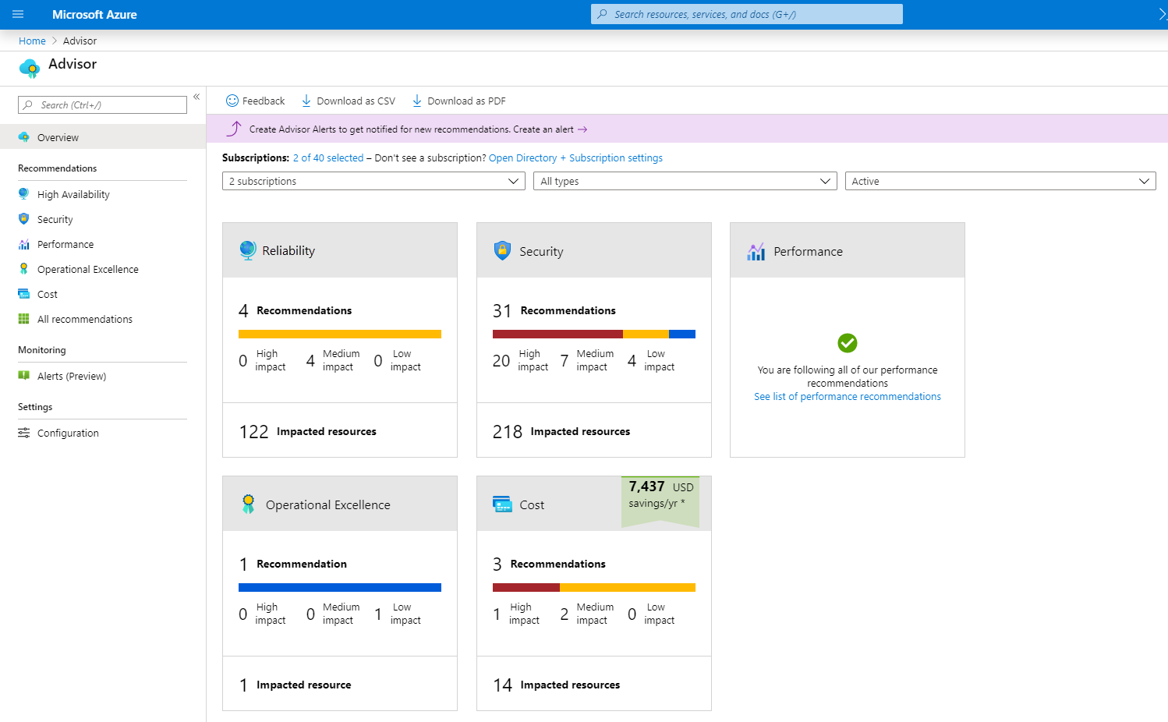
The following image shows the Azure Advisor dashboard.

Slide 7
Describe Azure Service Health
Azure Service Health is a feature in Azure that provides personalized guidance and support regarding the health of your Azure services. It gives you real-time information about the current status of Azure services and regions that you are using.
Azure Service Health provides notifications and alerts about service issues, planned maintenance, and other events that may impact the availability or performance of your Azure resources. It helps you stay informed and take proactive measures to ensure the smooth operation of your applications and services in Azure.

Slide 8
Azure Status:
Azure Status is a service provided by Microsoft Azure that provides real-time information about the health and availability of Azure services. It helps users stay informed about any ongoing issues, planned maintenance, or service advisories that may impact their Azure resources.
Azure Status provides updates and notifications about service disruptions, performance issues, and other important information to help users monitor and manage their Azure environment effectively.

Slide 9
Service Health:
Azure Service Health provides real-time information about the health and availability of Azure services. It helps you stay informed about any ongoing issues, planned maintenance, or service advisories that may impact your Azure resources. It's like having a personal health monitor for your Azure services!

Slide 10
Resource Health:
Resource health refers to the status and availability of specific resources within your Azure environment. It provides insights into the current condition of individual resources, such as virtual machines, databases, or storage accounts.
By monitoring resource health, you can quickly identify and address any issues or disruptions that may impact the performance or availability of your resources. It's like having a health check-up for each of your Azure resources!

Slide 11
Difference Between Azure Status, Service Health and Resource Health.
Azure Status provides information about the overall health of Azure services.
Service Health gives personalized guidance and support for your Azure services.
Resource Health focuses on the health and availability of individual resources within your Azure environment.

Slide 12
By using Azure status, Service health, and Resource health, Azure Service Health gives you a complete view of your Azure environment-all the way from the global status of Azure services and regions down to specific resources. Additionally, historical alerts are stored and accessible for later review.

Slide 13
Describe Azure Monitor:
Azure Monitor is a platform for collecting data on your resources, analyzing that data, visualizing the information, and even acting on the results. Azure Monitor can monitor Azure resources, your on-premises resources, and even multi-cloud resources like virtual machines hosted with a different cloud provider.

Slide 14
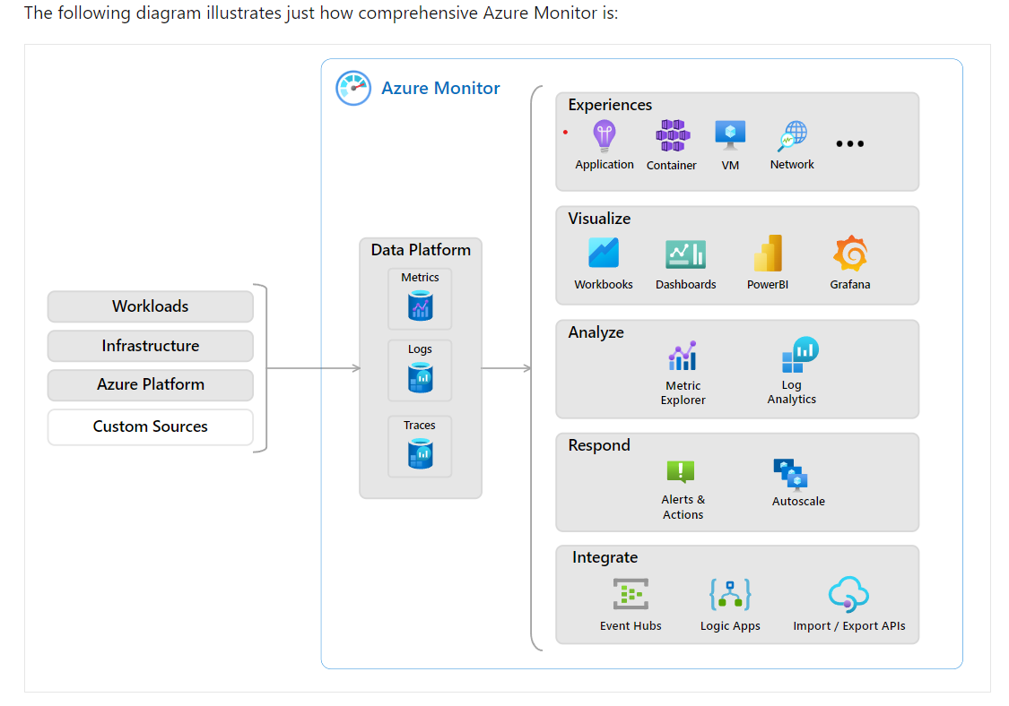

Slide 15
On the left is a list of the sources of logging and metric data that can be collected at every layer in your application architecture, from application to operating system and network.
In the center, the logging and metric data are stored in central repositories.
On the right, the data is used in several ways. You can view real-time and historical performance across each layer of your architecture or aggregated and detailed information. The data is displayed at different levels for different audiences. You can view high-level reports on the Azure Monitor Dashboard or create custom views by using Power BI and Kusto queries.

Slide 16
Additionally, you can use the data to help you react to critical events in real time, through alerts delivered to teams via SMS, email, and so on. Or you can use thresholds to trigger autoscaling functionality to scale to meet the demand.

Slide 17
Azure Log Analytics
Azure Log Analytics is the tool in the Azure portal where you’ll write and run log queries on the data gathered by Azure Monitor. Log Analytics is a robust tool that supports both simple, complex queries, and data analysis.
You can write a simple query that returns a set of records and then use features of Log Analytics to sort, filter, and analyze the records.

Slide 18
Azure Monitor Alerts
Azure Monitor Alerts are an automated way to stay informed when Azure Monitor detects a threshold being crossed. You set the alert conditions, the notification actions, and then Azure Monitor Alerts notifies when an alert is triggered.
Depending on your configuration, Azure Monitor Alerts can also attempt corrective action.

Slide 19
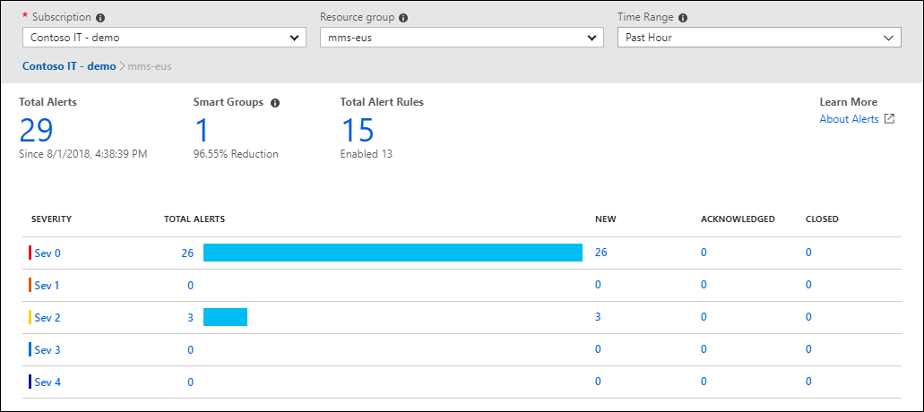

Slide 20
Application Insights:
Application Insights is a powerful monitoring and diagnostics tool provided by Azure. It helps developers gain insights into the performance and usage of their applications. With Application Insights, you can track metrics, detect and diagnose issues, and analyze user behavior.
It provides valuable data such as request rates, response times, and error rates, allowing you to optimize your application's performance and troubleshoot any issues. It's like having a detective for your application, helping you understand how it's performing and how users are interacting with it.

